Slide 1
THE LONDON UNDERGROUND GUIDE FOR DUMMIES
By Igoshin V. and Grishina V.

Slide 3
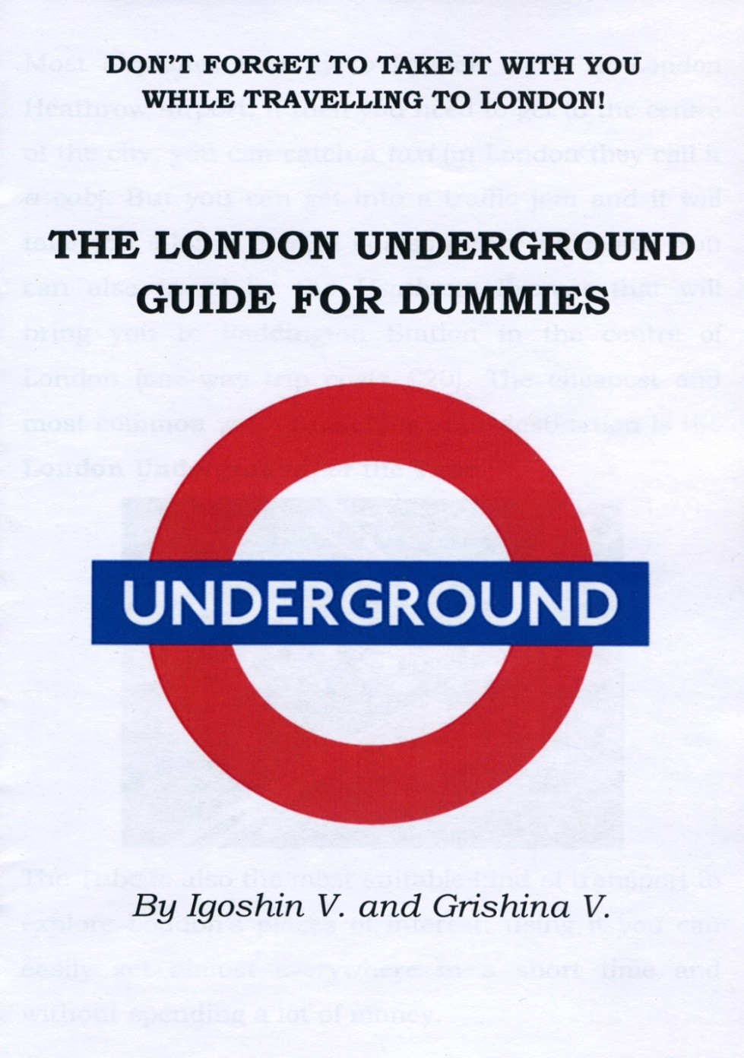

Slide 4
What does THE LONDON UNDERGROUND GUIDE FOR DUMMIES consist of?

Slide 5
Some historical facts

Slide 6
Explaining the London Underground zone system

Slide 7
Choosing the right type of a ticket or card

Slide 8
Choosing the right type of a ticket or card

Slide 9
Tip!
Do not forget to save your ticket or card until the end of the journey: you need it while going out or sometimes
changing lines!

Slide 10
The lines of the London Underground

Slide 11
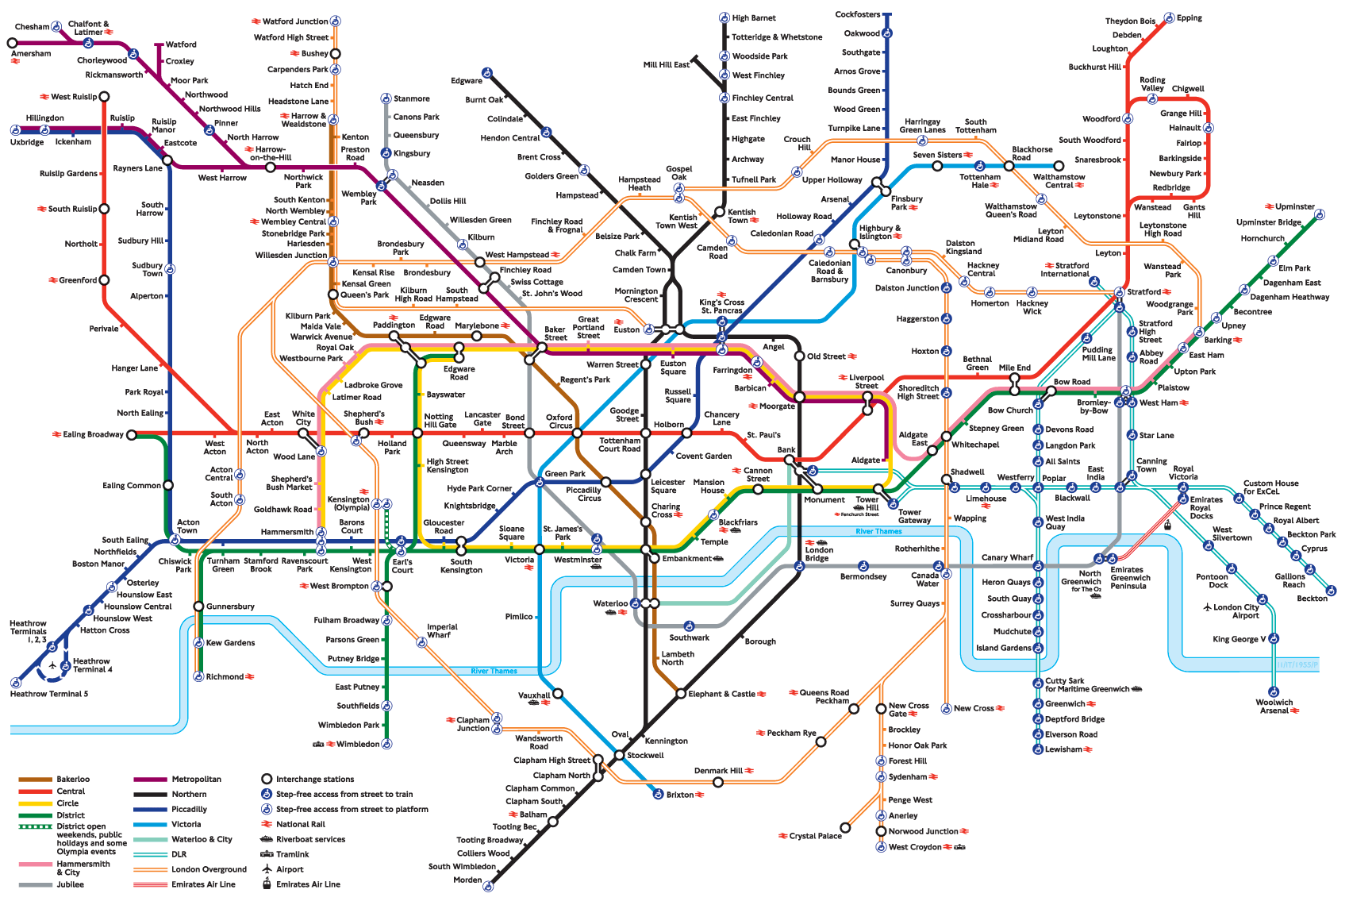

Slide 12
Choosing the right line and platform

Slide 13
Tip!
And always mind MIND THE GAP
between the train and the platform!

Slide 14
Describing the trains

Slide 15
Describing the trains

Slide 16
Getting to the main places of interest by Underground

Slide 17
Some curious facts

Slide 18
Some curious facts

Slide 20
THANK YOU FOR YOUR ATTENTION!

